Slide 1
Predicting Obesity
Not a Piece of Cake
SEIS 763 Project
by James Dedon, Eric Helander, Dan Ward, Lee Williams

Slide 2
Agenda
Introductions
Problem
Motivation
Dataset
Experiments & Statistical Techniques
Results
Summary

Slide 3
Introduction
Team
James Dedon
Eric Helander
Dan Ward
Lee Williams

Slide 4
Problem
Looking at behavioral, lifestyle, and socio-economic factors can we predict an individuals health.
Notes:
Targets: BMI, General Health
Independent Variables: Drinking Soda, Eating Fast Food, Income, Exercise

Slide 5
Motivation
Poor health results in a lower quality of life and has a negative impact on ones finances.
By being able to identify factors that are predictive of negative health outcomes, we would be able to intervene earlier.

Slide 6
Dataset - Structure
Respondent file from the Eating & Health Module of the 2014 American Time Use Survey
The dataset was provided as an excel file and is made up of 11,212 observations with 37 attributes
The 37 attributes were made up of a range of behavioral, lifestyle, and socio-economic factors
10 attributes are numerical
27 attributes are categorical
We identified two health attributes to be used as target variables
BMI (erbmi)
Used as a numerical target (raw number)
Used as a categorical (<18.5 underweight, between 18.5 & 24.9 Normal Weight, etc…)
General Health (eugenhth)
Categorical (Excellent, Very Good, Good, Fair, Poor)

Slide 7
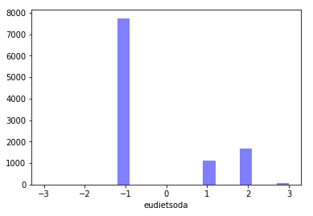
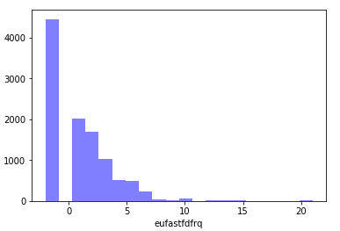
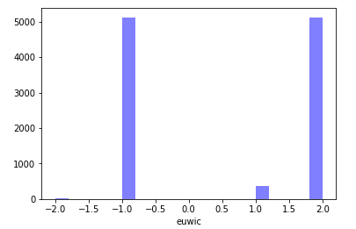
Dataset - Missing Values

Slide 8
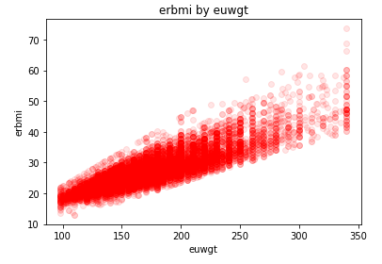
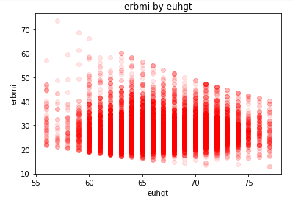
Dataset - Interesting Observations

Slide 9
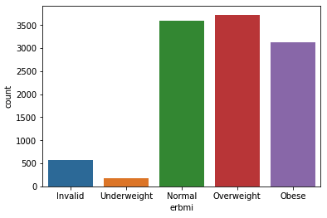
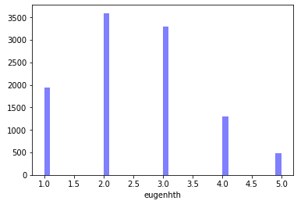
Dataset - Interesting Observations

Slide 10
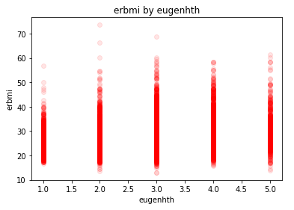
Dataset - Interesting Observations

Slide 11
Dataset - Data Prep & Cleaning
Data cleaning
Dropped invalid BMI entries
Approaches
Split_data via np.random.RandomState(0).permutation(dataset.shape[0])
Label encoding
Scaling
One hot encoding via pd.get_dummies()

Slide 12
Experiments & Statistical Techniques
Approaches
Manual experimentation
SelectKBest
Recursive feature elimination with cross validation (RFECV)
Grid search
Challenges
Curse of dimensionality
Interpretability
Long-running models
Including the prediction among the predictors

Slide 13
Decision Trees
Motivation
Structured Variables
Goal of identifying predictors

Slide 14
Decision Trees
Data Preparation
Remove rows missing target data
Remove useless variables
Combine Income
Categorize BMI
One-Hot Categories

Slide 15
Decision Trees
General Health Classifier Results
Key factors: BMI and income
Additional: exercise and eating habits

Slide 16
Decision Trees
BMI Classifier Results
Key factor: Exercise Frequency
Mitigations: not receiving SNAP, eating habits
Other factors: diet soda, hunger

Slide 17
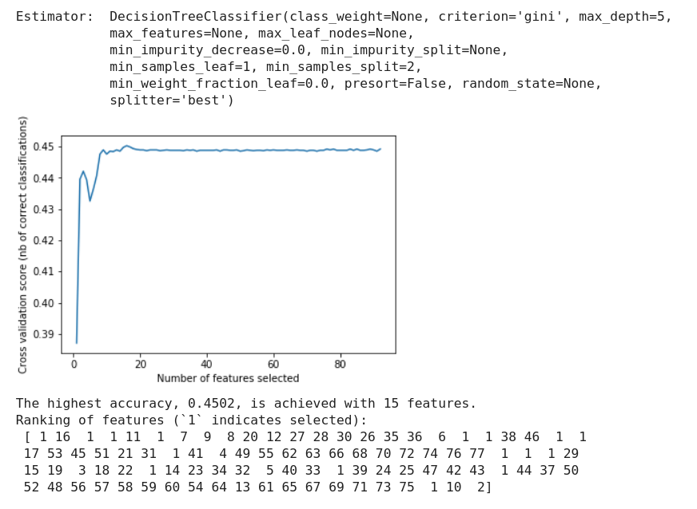
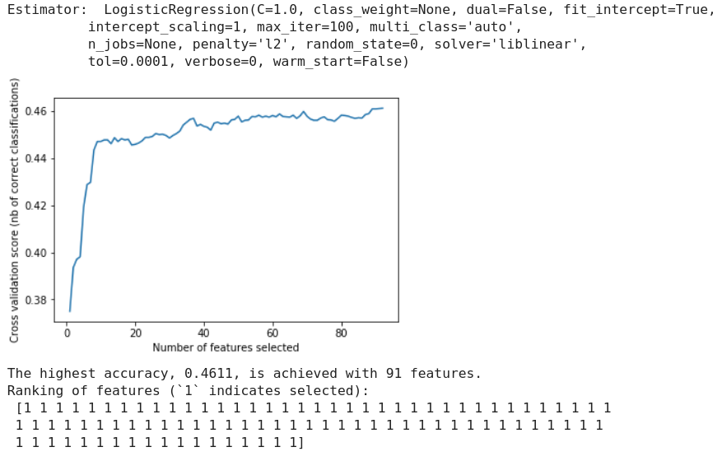
Results
Model Accuracies
Model Compatibilities

Slide 18
Summary
Categorical values are hard
Health and BMI aren’t as easily explained as we might think.
Choosing the right problem to solve is important
There’s a lot out there yet to learn in ML (no surprise)

Slide 19
References
REFERENCES
[1] CMS.gov, (12/11/2018). National Health Expenditure Data - Historical. Retrieved from https://www.cms.gov/research-statistics-data-and-systems/statistics-trends-and-reports/nationalhealthexpenddata/nationalhealthaccountshistorical.html
[2] World Health Organization (2009), WHO Guide to Identifying the Economic Consequences of Disease and Injury. Retrieved from https://www.who.int/choice/publications/d_economic_impact_guide.pdf?ua=1.
[3] National Heart, Lung, and Blood Institute. Assessing Your Weight and Health Risk. Retrieved from https://www.nhlbi.nih.gov/health/educational/lose_wt/risk.htm
[4] United States Department of Labor, Bureau of Labor Statistics(June 28, 2018). American Time Use Survey. Retrieved from https://www.bls.gov/tus/overview.htm#1.
[5] United States Department of Labor, Bureau of Labor Statistics(July, 2017). American Time Use Survey (ATUS) Data Dictionary: 2014-16 Eating & Health Module Data Variables collected in ATUS Eating and Health Module July 2017.. Retrieved from https://www.bls.gov/tus/ehmintcodebk1416.pdf.
[6] United States Department of Labor, Bureau of Labor Statistics(December, 2017). American Time Use Survey Eating & Health Module 2014-16 Questionnaire December 2017. Retrieved from https://www.bls.gov/tus/ehmquestionnaire1416.pdf .
[7] United States Department of Agriculture, Economic Research Service (May 2016). 2014-16 Eating & Health Module User’s Guide (2016 Edition). Retrieved from https://www.ers.usda.gov/publications/pub-details/?pubid=42817 .
[8] United States Bureau of Labor Statistics (2014). Eating & Health Module Dataset, American Time Use Survey (ATUS) Eating & Health Module Files from 2014. Retrieved from https://www.kaggle.com/bls/eating-health-module-dataset#ehresp_2014.csv .
[9] Margaret Gough, Adam M. Lippert and Molly A. Martin. 2019. The Role of Time Use Behaviors in the Risk of Obesity among Low-Income Mothers. In Women's Health Issues 29-1 (2019) 23-30. https://www.whijournal.com/article/S1049-3867(17)30727-2/pdf.
[10] Jennifer Bennett Shinall. 2016. Occupational Characteristics and the Obesity Wage Penalty. In Social Science Research Network. https://papers.ssrn.com/sol3/papers.cfm?abstract_id=2379575.
[11] Karen S. Hamrick and Ket McClelland. 2016. Americans’ Eating Patterns and Time Spent on Food: The 2014 Eating & Health Module Data. In Economic Information Bulletin Number 158. https://ageconsearch.umn.edu/record/262141/files/60064_eib158.pdf.
[12] Karen S. Hamrick and Margaret Andrews. 2016. SNAP Participants’ Eating Patterns over the Benefit Month: A Time Use Perspective. In PLoS ONE 11(7). https://journals.plos.org/plosone/article/file?id=10.1371/journal.pone.0158422&type=printable.
[13] Karen S. Hamrick, Margaret Andrews, Joanne Guthrie, David Hopkins and Ket McClelland. 2011. How Much Time Do Americans Spend on Food? Economic Information Bulletin Number 86. https://foodtechconnect.com/wp-content/uploads/2011/11/WhereEat.pdf.

